Slide 1

End-of-Year Report
2023

Slide 2
18 ERCs Referenced in Slides 1–5
NSF Nanosystems Engineering Research Center for Nanomanufacturing Systems for Mobile Computing and Mobile Energy Technologies at University of Texas (NASCENT) (Class: 2012; AY: 2012 – 2023; RY: 2012 – 2023)* | NSF Engineering Research Center for the Internet of Things for Precision Agriculture (IoT4Ag) (Class: 2020; AY: 2020 – 2023; RY: 2020 – 2023)*
NSF Nanosystems Engineering Research Center for Advanced Self-Powered Systems of Integrated Sensors and Technologies (ASSIST) (Class: 2012; AY: 2012 – 2023; RY: 2012 – 2023)* | Nanosystems Engineering Research Center for Nanotechnology Enabled Water Treatment Systems at Rice University (NEWT) (Class: 2015; AY: 2015 – 2023; RY: 2015 – 2023)*
Engineering Research Center for Bio-­mediated and Bio­inspired Geotechnics at Arizona State University (CBBG) (Class: 2015; AY: 2015 – 2023; RY: 2015 – 2023)* | ERC for Precise Advanced Technologies and Health Systems for Underserved Populations at Texas A&M University (PATHS-UP) (Class: 2017; AY: 2017 – 2023; RY: 2017 – 2023)*
ERC for Directed Multiscale Assembly of Cellular Metamaterials with Nanoscale Precision at Boston University (CELL-MET) (Class: 2017; AY: 2017 – 2023; RY: 2017 – 2023)* | ERC for Power Optimization for Electro­Thermal Systems at University of Illinois (POETS) (Class: 2015; AY: 2015 – 2023; RY: 2015 – 2023)*
ERC for Innovative and Strategic Transformation of Alkane Resources at Purdue University (CISTAR) (Class: 2017; AY: 2017 – 2023; RY: 2017 – 2023)* | Nanosystems Engineering Research Center for Translational Applications of Nanoscale Multiferroic Systems at University of California Los Angeles (TANMS) (Class: 2012; AY: 2012 – 2023; RY: 2012 – 2023)*
ERC for Cell Manufacturing Technologies at Georgia Institute of Technology (CMaT) (Class: 2017; AY: 2017 – 2023; RY: 2017 – 2023)* | NSF Engineering Research Center for Quantum Networks (CQN) (Class: 2020; AY: 2020 – 2023; RY: 2020 – 2023)*
NSF Engineering Research Center for Advancing Sustainability through Powered Infrastructure for Roadway Electrification (ASPIRE) (Class: 2020; AY: 2020 – 2023; RY: 2020 – 2023)* | ERC for Smart Streetscapes (CS3) (Class: 2022; AY: 2022 – 2023; RY: 2022 – 2023)*
NSF Engineering Research Center for Advanced Technologies for Preservation of Biological Systems (ATP-Bio) (Class: 2020; AY: 2020 – 2023; RY: 2020 – 2023)* | ERC for Hybrid Autonomous Manufacturing Moving from Evolution to Revolution (HAMMER) (Class: 2022; AY: 2022 – 2023; RY: 2022 – 2023)*
ERC for Advancing Sustainable and Distributed Fertilizer Production (CASFER) (Class: 2022; AY: 2022 – 2023; RY: 2022 – 2023)* | ERC for Precision Microbiome Engineering (PreMiEr) (Class: 2022; AY: 2022 – 2023; RY: 2022 – 2023)*
*AY and RY denotes the Award Year and Reporting Year Range
Notes:
ERCs Referenced in Slides 1-5

Slide 3
“Annualized ERCs” on slides 1–5 include the 18 ERCs from the previous slide and the following additional 9 ERCs
ERC for Revolutionizing Metallic Biomaterials at North Carolina A&T State University (NCAT) (Class: 2008; AY: 2008 – 2020; RY: 2008 – 2020)* | ERC for Ultra-wide-area Resilient Electric Energy Transmission Networks at University of Tennessee (CURENT) (Class: 2011; AY: 2011 – 2021; RY: 2011 – 2021)*
Center for Neurotechnology at University of Washington (CNT) (Class: 2011; AY: 2011 – 2021; RY: 2011 – 2021)* | ERC for Re-inventing the Nation's Urban Water Infrastructure (ReNUWIt) (Class: 2011; AY: 2011 – 2021; RY: 2011 – 2021)*
ERC for Integrated Access Networks at the University of Arizona (CIAN) (Class: 2008; AY: 2008 – 2019; RY: 2008 – 2019)* | Future Renewable Electric Energy and Management Systems Center at North Carolina State University (FREEDM) (Class: 2008; AY: 2008 – 2019; RY: 2008 – 2019)*
Center for Biorenewable Chemicals at Iowa State University (IOWA) (Class: 2008; AY: 2008 – 2019; RY: 2008 – 2019)* | ERC for Quantum Energy and Sustainable Solar Technologies at Arizona State University (QESST) (Class: 2011; AY: 2011 – 2022; RY: 2011 – 2022)*
ERC for Lighting Enabled Systems & Applications at Rensselaer Polytechnic Institute (LESA) (Class: 2008; AY: 2008 – 2019; RY: 2008 – 2019)*
*AY and RY denotes the Award Year and Reporting Year Range
Notes:
“Annualized ERCs” on slides 1–5 include the 18 ERCs from the previous slide and the following additional 9 ERCs

Slide 4
ERC Products of Innovation, FY 1985–2023*
 | FY 2023 (18 ERCs) |  | FY 2018–2022 Annualized |  | FY 1985–2023 (73 ERCs)
Intellectual Property Transaction | Total | Per Center | Total | Per Center | Total
Inventions Disclosed | 84 | 5 | 57 | 3 | 2,770
Patent Applications Filed (Provisional and Full) | 88 | 5 | 79 | 5 | 2,498
Patents Awarded | 26 | 1 | 19 | 1 | 955
Licenses Issued | 1 | < 1 | 9 | 1 | 1,401
Economic Development | Total | Per Center | Total | Per Center | Total
Spinoff Companies | 3 | < 1 | 7 | < 1 | 253
Spinoff Employees | 3 | < 1 | 49 | 3 | 1,644
* Does not include centers from the Earthquake Technology Sector

Slide 5
ERC Influence on Curriculum, FY 1985–2023*
 | FY 2023 (18 ERCs) |  | FY 2018–2022 Annualized |  | FY 1985–2023 (73 ERCs)
Degrees | Total | Per Center | Total | Per Center | Total
New Full-Degree Programs Based on ERC Research | 1 | < 1 | 1 | < 1 | 58
New Degree Minors Based on ERC Research | 14 | 1 | 1 | < 1 | 49
New Certificate Programs Based on ERC Research | 0 | < 1 | 2 | < 1 | 48
Courses | Total | Per Center | Total | Per Center | Total
New Courses Based on ERC Research | 45 | 3 | 31 | 2 | 1,205
Ongoing Courses With ERC Content | 155 | 9 | 217 | 13 | 3,993
Course Modules Based on ERC Research | 43 | 2 | 33 | 2 | 856
Textbooks | Total | Per Center | Total | Per Center | Total
New Textbooks Based on ERC Research | 2 | < 1 | 3 | < 1 | 191
New Textbook Chapters Based on ERC Research | 1 | < 1 | 3 | < 1 | 113
* Does not include centers from the Earthquake Technology Sector

Slide 6
ERC Information Dissemination, FY 1985–2023*
 | FY 2023 (18 ERCs) |  | FY 2018–2022 Annualized |  | FY 1985–2023 (73 ERCs)
Peer-Reviewed Publications (Total) | Total | Per Center | Total | Per Center | Total
Journals** | 627 | 35 | 798 | 47 | 26,981
Conference Proceedings** | 188 | 10 | 360 | 21 | 19,189
Trade Journals | 31 | 2 | 12 | 1 | 712
Coauthored With ERC Students | 433 | 24 | 454 | 26 | 14,269
Education and Outreach | Total | Per Center | Total | Per Center | Total
Education and Colloquia | 636 | 35 | 665 | 39 | 19,237
Workshops, Short Courses, and Webinars | 288 | 16 | 380 | 22 | 7,014
* Does not include centers from the Earthquake Technology Sector
** Includes publications that result from center support, associated projects, and sponsored projects

Slide 7
Curricular Impact of ERCs, FY 2007–2023*
 | FY 2023 (18 ERCs) |  | FY 2018–2022 Annualized |  | FY 2007–2023 (47 ERCs)
New and Ongoing Courses, Workshops, Short Courses, Webinars, and Textbooks Based on ERC Research | Total | Per Center | Total | Per Center | Total
With Engineered-System Focus | 172 | 10 | 272 | 16 | 4,652
With Multidisciplinary Content | 230 | 13 | 246 | 14 | 4,185
Offered at Undergraduate Level | 196 | 11 | 201 | 12 | 3,076
Offered at Graduate Level | 252 | 14 | 263 | 15 | 4,109
Used at More Than One ERC Institution | 130 | 7 | 147 | 8 | 1446
Team Taught by Faculty in More Than One Department | 58 | 3 | 122 | 7 | 1256
* Does not include centers from the Earthquake Technology Sector
** Data collection of curricular impacts started in 2007

Slide 8
ERC Student Degrees, FY 1985–2023*
 | FY 2023 (18 ERCs) |  | FY 2018–2022 Annualized |  | FY 1985–2023 (73 ERCs)
Degree Type | Total | Per Center | Total | Per Center | Total
Bachelor’s | 73 | 4 | 98 | 6 | 4,847
Master’s | 50 | 3 | 63 | 4 | 4,524
Doctoral | 115 | 6 | 141 | 8 | 5,610
Total | 238 | 13 | 302 | 18 | 14,981
* Does not include centers from the Earthquake Technology Sector

Slide 9
Degrees Granted to ERC Students vs. All U.S. Engineering Graduates, FY 2017–2023
Degrees Granted to ERC Students*
(Domestic and Foreign Students)
Degrees Granted From All U.S. Engineering Schools
(Domestic and Foreign Students)
Total
Degrees
Granted
354
381
287
306
249
287
238
201260
214698
216298
218310
218472
205738
210715
* Does not include centers from the Earthquake Technology Sector
Data Source: American Society for Engineering Education (ASEE) (http://edms.asee.org)

Slide 10
ERC Graduate Employment (18 Centers), FY 2023
Notes:
Foreign industry versus foreign industrial/practitioner member distinction cannot currently be made. Specifically, this slide displays data entered in the Quantifiable Outputs section under the Degrees and Jobs tab. Centers are only required to enter a total number based on industry type and degree earned; ERCWeb does not track individual graduates to individual organizations.

Slide 11
ERC Research and Education Personnel, by Underrepresented Group and Citizenship Status, FY 2023
Personnel Category | Total | Total U.S. Citizens and Permanent Residents | Women* |  | Underrepresented Racial Minorities* |  | Hispanic* |  | Foreign
 |  |  | Number | % | Number | % | Number | % | Number | %
Faculty
Total | 647 | 547 | 180 | 33% | 52 | 10% | 48 | 9% | 52 | 8%
Graduate Students
Postdocs | 174 | 49 | 14 | 29% | 1 | 2% | 12 | 24% | 111 | 64%
Graduate Students | 1,023 | 431 | 170 | 39% | 61 | 14% | 66 | 15% | 456 | 45%
Doctoral | 826 | 346 | 146 | 42% | 49 | 14% | 50 | 14% | 391 | 47%
Master’s | 198 | 85 | 24 | 28% | 12 | 14% | 16 | 19% | 66 | 33%
Total** | 1,195 | 480 | 184 | 38% | 62 | 13% | 78 | 16% | 565 | 47%
Undergraduate Students
ERC Undergraduate Students (Research Assistants, Non-REU Students) | 514 | 304 | 134 | 44% | 40 | 13% | 74 | 24% | 25 | 5%
NSF REU Site Award Students | 47 | 45 | 23 | 51% | 11 | 24% | 11 | 24% | 0 | 0%
Center Funding Students | 136 | 115 | 57 | 50% | 20 | 17% | 32 | 28% | 7 | 5%
Other NSF Supplemental Funding Students | 16 | 16 | 8 | 50% | 12 | 75% | 2 | 13% | 0 | 0%
Total** | 684 | 460 | 213 | 46% | 80 | 17% | 111 | 24% | 27 | 4%
Community College
Participants in RET Program | 5 | 3 | 2 | 67% | 2 | 67% | 0 | 0% | 0 | 0%
K–12 Teachers
K–12 RET | 85 | 74 | 39 | 53% | 11 | 15% | 23 | 31% | 0 | 0%
K–12 Non-RET | 57 | 49 | 32 | 65% | 9 | 18% | 18 | 37% | 1 | 2%
Total | 142 | 123 | 71 | 58% | 20 | 16% | 41 | 33% | 1 | 1%
Young Scholars
Total | 134 | N/A | N/A | N/A | N/A | N/A | N/A | N/A | N/A | N/A
Grand Total*** | 2,816 | 1,622 | 656 | 40% | 217 | 13% | 282 | 17% | 645 | 24%
* U.S. citizens and permanent residents only
** The sum of the number of personnel for each row may exceed the total because personnel may belong to multiple categories
*** Leadership/Administration Directors, Research Thrust Leaders, and Engineering Workforce Development Program Leaders are included in the Grand Total. For the Grand Total row, all columns exclude Young Scholars, except the Total column
NOTE: For years in which the center entered demographic data by institution rather than per person, data are not included
Notes:
The demographic breakdown does not include counts of personnel who did not report citizenship. Therefore, the total U.S. Citizens and Permanent Residents plus the total Foreign residents (599) is lower than the grand total of 647, as there were 48 individuals marked as faculty who did not provide their citizenship information in 2023. Total faculty is now as follows: U.S. Citizens and Permanent Residents: 547, Foreign residents: 52, Not reported: 48.

Slide 12
Participants Impacted by ERC Engineering Education Activities, FY 2023
Outreach Participants | Total
Community College Events
Faculty Who Attended ERC-Sponsored Educational Outreach Events | 99
Students Who Attended ERC-Sponsored Educational Outreach Events | 368
Total | 467
K–12 Events
Pre-college K–12 Teachers | 4,912
K–12 Students | 31,737
Total | 36,649
Grand Total | 37,116

Slide 13
Women in ERCs, FY 2018–2023
166 | 127 | 122 | 154 | 128 | 180 |  | 33 | 26 | 24 | 21 | 16 | 14 |  | 178 | 156 | 169 | 157 | 139 | 146 |  | 51 | 39 | 37 | 34 | 33 | 24 |  | 383 | 350 | 316 | 312 | 286 | 213
NOTES:
Data from centers are not included for years in which the center entered demographic data by institution rather than per person
Both ERC data and National statistics are for U.S. citizens and permanent residents only
Undergraduates include REU students
The percentages of women are calculated out of the total number of U.S. citizens and permanent residents, including personnel who did not report gender
ASEE data were not collected postdoctoral for 2019, 2020, 2021, 2022 and 2023
The percentages of personnel who did not report gender are as follows: 2018: 10.67%, 2019: 10.95%, 2020: 9.94%, 2021: 10.36%, 2022: 10.62%, 2023: 11.80%
Notes:
Reported percentages of personnel do not include data from centers that entered their demographics by institution, vs. individual.

Slide 14
Hispanics and Latinos in ERCs, FY 2018–2023
55 | 49 | 50 | 49 | 50 | 48 |  | 5 | 4 | 3 | 5 | 6 | 12 |  | 56 | 43 | 49 | 67 | 60 | 50 |  | 28 | 24 | 23 | 21 | 21 | 16 |  | 159 | 186 | 140 | 147 | 148 | 111
NOTES:
Data from centers are not included for years in which the center entered demographic data by institution rather than per person
Both ERC data and National statistics are for U.S. citizens and permanent residents only
Undergraduates include REU students
The percentages of Hispanics and Latinos are calculated out of the total number of U.S. citizens and permanent residents, including personnel who did not report ethnicity
ASEE data were not collected postdoctoral for 2018–2023
The percentages of personnel who did not report ethnicity are as follows: 2018: 15.81%, 2019: 15.57%, 2020: 15.11%, 2021: 14.17%, 2022: 16.18%, 2023: 16.74%
Notes:
Reported percentages of personnel do not include data from centers that entered their demographics by institution, vs. individual.

Slide 15
Underrepresented Racial Minorities in ERCs, FY 2018–2023
44 | 26 | 26 | 41 | 33 | 52 |  | 6 | 2 | 2 | 4 | 1 | 1 |  | 38 | 31 | 40 | 46 | 41 | 49 |  | 21 | 10 | 7 | 6 | 5 | 12 |  | 150 | 111 | 99 | 109 | 92 | 80
NOTES:
Data from centers are not included for years in which the center entered demographic data by institution rather than per person
Both ERC data and National statistics are for U.S. citizens and permanent residents only
Undergraduates include REU students
The percentages of underrepresented racial minorities are calculated out of the total number of U.S. citizens and permanent residents, including personnel who did not report race
ASEE data were not collected for postdoctoral for 2018–2023
The percentages of personnel who did not report race are as follows: 2018: 16.91%, 2019: 17.68%, 2020: 16.37%, 2021: 16.46%, 2022: 19.12%, 2023: 19.79%
Notes:
Reported percentages of personnel do not include data from centers that entered their demographics by institution, vs. individual.

Slide 16
Persons With Disabilities in ERCs, FY 2018–2023
10 | 10 | 10 | 16 | 9 | 20 |  | 2 | 2 | 2 | 2 | 1 | 1 |  | 14 | 11 | 12 | 12 | 13 | 15 |  | 2 | 2 | 4 | 5 | 5 | 7 |  | 21 | 18 | 24 | 27 | 15 | 25
NOTES:
Data from centers are not included for years in which the center entered demographic data by institution rather than per person
Undergraduates include REU students
The percentages of persons with disabilities are calculated out of the total number of U.S. citizens and permanent residents, including personnel who did not report disability status
The national percentages for persons with disabilities are for all persons, regardless of citizenship. The national percentages for doctoral students with disabilities and master’s students with disabilities are from the national percentages for graduate students (master’s and doctoral students combined)
ASEE data are only available for faculty for 2019
The percentages of personnel who did not report disability status are as follows: 2018: 20.44%, 2019: 21.66%, 2020: 18.34%, 2021: 17.21%, 2022: 17.31%, 2023: 19.21%
Notes:
Reported percentages of personnel do not include data from centers that entered their demographics by institution, vs. individual.

Slide 17
U.S. Citizens and Permanent Residents in ERCs, FY 2018–2023
635 | 464 | 470 | 570 | 485 | 547 |  | 79 | 57 | 52 | 62 | 48 | 49 |  | 505 | 417 | 438 | 433 | 376 | 346 |  | 163 | 104 | 106 | 107 | 99 | 85 |  | 820 | 694 | 594 | 612 | 573 | 460
NOTES:
Data from centers are not included for years in which the center entered demographic data by institution rather than per person
Undergraduates include REU students
The percentages of U.S. citizens and permanent residents are calculated out of the total number of personnel, including personnel who did not report citizenship
ASEE data are not available for postdoctoral for 2019-2023
The percentages of personnel who did not report citizenship are as follows: 2018: 13.09%, 2019: 12.73%, 2020: 12.64%, 2021: 12.12%, 2022: 14.63%, 2023: 15.47%
Notes:
Reported percentages of personnel do not include data from centers that entered their demographics by institution, vs. individual.

Slide 18
Personnel Conducting ERC Research, FY 2023
REU Students
(183 total; 4% foreign)
Faculty
(270 total; 11% foreign)
Undergraduates
(160 total; 7% foreign)
Postdoctoral Students
(75 total; 69% foreign)
Master’s Students
(70 total; 57% foreign)
Doctoral Students
(397 total; 52% foreign)
Domestic Personnel: 807 Foreign Personnel: 345
NOTES:
The sum of the number of personnel for each category may exceed the total number of personnel because personnel may belong to multiple categories
Percentage of foreign personnel is calculated out of domestic and foreign personnel, excluding personnel who did not report citizenship
Notes:
This slide includes the following subset of faculty: Senior Faculty, Junior Faculty, or Visiting Faculty (under the Research Under Strategic Research Plan classification). Personnel marked as Faculty under the Curriculum Under Strategic Curriculum Plan, only, are not included.

Slide 19
Citizenship in ERCs, FY 2018–2023
U.S. Citizens and Permanent Residents
Foreign Citizens
2023
2018
2019
2020
2021
2022
Citizenship Not Reported
Faculty
Postdoctoral
Doctorate
Master’s
Undergraduate

Slide 20
ERC Industrial/Practitioner Members and Supporting Organizations, FY 2017–2023*
17
(Totals)
(522)
(597)
(484)
(521)
(475)
(389)
(393)
* Does not include centers from the Earthquake Technology Sector
Notes:
Contributing Organization—An organization that provides non-project-specific support to the ERC through grants, equipment, or other real donations but does not satisfy all criteria for full membership.
Industrial/Practitioner Member—An organization that satisfies all requirements for membership according to the Center's membership agreement and cooperative agreement. Organizations must sign a membership agreement and provide a sufficient level of financial support (cash or in-kind) according to the Center's membership agreement during the Reporting Year. Centers may define different levels of membership. One exception is that a signed membership agreement is not required for members in a government sector. Sectors include the Federal Government, State government, local government, quasi-government research, industry, industry association, medical facility, private foundation, nonprofit, consulting firm, or other. The total amount of cash or in-kind support provided by members is reported in Table 9: Sources of Support.
Associated Project—A project that is central to either the research strategic plan or education strategic plan that is awarded to the home department of an ERC faculty member. Associated project funds are not controlled by the Center and are reported as indirect sources of support. Only direct costs for these projects should be reported (no indirect costs or reserves remaining).
Sponsored Project—Projects with a restricted or directed purpose that is specified by the funding source. Sponsored projects augment the Center's core activities. The award goes directly to the Center for a specific project and is classified as restricted cash. Examples of sponsored projects include REU supplements, Defense Advanced Research Projects Agency (DARPA) awards to the Center, and industry-sponsored projects with clearly intended outcomes or activities.

Slide 21
ERC Industrial/Practitioner Members and Supporting Organizations, FY 2017–2023*
 | FY 2017 | FY 2018 | FY 2019 | FY 2020 | FY 2021 | FY 2022 | FY 2023
Organization Type
Contributing Organizations | 72 | 93 | 100 | 120 | 53 | 35 | 47
Funders of Associated Projects | 144 | 157 | 108 | 113 | 126 | 98 | 97
Funders of Sponsored Projects | 12 | 28 | 11 | 10 | 6 | 12 | 11
Foreign Industrial/Practitioner Members | 45 | 45 | 31 | 38 | 40 | 37 | 36
U.S. Industrial/Practitioner Members | 249 | 274 | 234 | 240 | 250 | 207 | 202
Total Number of Organizations | 522 | 597 | 484 | 521 | 475 | 389 | 393
Total Number of Centers | 16 | 19 | 19 | 15 | 18 | 15 | 18
Average Number of Organizations per Center | 33 | 31 | 25 | 35 | 26 | 26 | 22
* Does not include centers from the Earthquake Technology Sector

Slide 22
Industrial/Practitioner Member Support by Year, FY 2017–2023*
 | FY 2017 | FY 2018 | FY 2019 | FY 2020 | FY 2021 | FY 2022 | FY 2023**
Type of Support
Total Membership Fees | $3,786,620 | $4,105,519 | $3,505,352 | $3,329,864 | $2,699,714 | $3,889,583 | $3,068,104
Member-Sponsored Projects Total Dollar Amount | $1,440,493 | $1,344,913 | $662,354 | $691,321 | $434,796 | $376,869 | $112,408
Member-Associated Projects Total Dollar Amount | $2,772,841 | $2,690,570 | $1,506,932 | $1,475,615 | $1,359,434 | $5,305,913 | $5,755,192
Member In-Kind Total Dollar Amount*** | $2,384,789 | $1,914,975 | $1,486,785 | $1,139,124 | $890,196 | $1,110,903 | $696,937
Total Dollar Amount, Industrial/Practitioner Member Support to Center | $10,384,743 | $10,055,977 | $7,161,423 | $6,635,924 | $5,384,140 | $10,683,268 | $9,632,641
* Does not include centers from the Earthquake Technology Sector
** Support received by the end of the current reporting year. Includes data for centers that have entered partial data during a no-cost extension (NCE)
*** Data for this row are from the In-Kind Support reported in the Organizations section

Slide 23
Industrial/Practitioner Member Support by Year, FY 2017–2023*
* Does not include centers from the Earthquake Technology Sector
** Support received by the end of the current reporting year. Includes data for centers that have entered partial data during a no-cost extension (NCE)
*** Data for this line are from the In-Kind Support reported in the Organizations section

Slide 24
Distribution of Industrial/Practitioner Members by Industry Size, FY 2019–2023
NOTES:
The total number of firms is as follows: 2019: 222, 2020: 239, 2021: 263, 2022: 229, 2023: 222
Industry sizes are as follows: Small = <500 employees, Medium = 500–1,000 employees, Large = >1,000 employees

Slide 25
Total ERC New Cash Support, FY 2023 (18 ERCs)
Direct Support Associated Support
Total value of support: $178 million
NOTES:
Percentages shown are Direct Support and Associated Support combined
Non-NSF Government includes U.S. Government (Not NSF), State Government, Local Government, Foreign Government, and Quasi- government Research Organizations
Other Sources include Medical Facilities, Nonprofit Organizations, Private Foundations, Venture Capitalists and Other Sources
Notes:
Total only includes Cash Support (Direct and Indirect) and Associated Project Support.

Slide 26
Functional Budgets of ERCs in the Aggregate, FY 2023*
Direct Support total: $78,777,928
* Includes in-kind support but not residuals

Slide 27
Industrial/Practitioner New Support to 18 ERCs, FY 2023
Total value of support: $3.9 million

Slide 28
Non-NSF Government Support by ERC Technology Sector, FY 2017–2023*,**,***
25
* Does not include centers from the Earthquake Technology Sector
** Support includes Unrestricted Cash, Restricted Cash, and In-Kind Support
*** Includes data for centers that have entered partial data during a no-cost extension (NCE)
Notes:
Counts of ERCs by sector and year:
Advanced Manufacturing Sector—2013: 5, 2014: 5, 2015: 5, 2016: 5, 2017: 3, 2018: 2, 2019: 3
Biotechnology and Healthcare Sector—2013: 5, 2014: 4, 2015: 4, 2016: 3, 2017: 3, 2018: 6, 2019: 5
Energy, Sustainability, and Infrastructure Sector—2013: 5, 2014: 5, 2015: 5, 2016: 6, 2017: 6, 2018: 7, 2019: 7
Micro/Optoelectronics, Sensing, and Information Technology Sector—2013: 5, 2014: 3, 2015: 3, 2016: 5, 2017: 4, 2018: 4, 2019: 4

Slide 29
Industry Support by ERC Technology Sector, FY 2017–2023 *,**,***
* Does not include centers from the Earthquake Technology Sector
** Support includes Unrestricted Cash, Restricted Cash, and In-Kind Support
*** Includes data for centers that have entered partial data during a no-cost extension (NCE)
Notes:
Counts of ERCs by sector and year:
Advanced Manufacturing Sector— 2013: 5, 2014: 5, 2015: 5, 2016: 5, 2017: 3, 2018: 2, 2019: 3
Biotechnology and Healthcare Sector— 2013: 5, 2014: 4, 2015: 4, 2016: 3, 2017: 3, 2018: 6, 2019: 5
Energy, Sustainability, and Infrastructure Sector— 2013: 5, 2014: 5, 2015: 5, 2016: 6, 2017: 6, 2018: 7, 2019: 7
Micro/Optoelectronics, Sensing, and Information Technology Sector—2013: 5, 2014: 3, 2015: 3, 2016: 5, 2017: 4, 2018: 4, 2019: 4

Slide 30
FY 2023 Sources of Support to 18 ERCs, by Technology Sector
Direct Support Associated Support
Total value of support: $179 million
NOTE: Sources of Support include Unrestricted Cash, Restricted Cash, In-Kind, and Associated Projects. Residuals are not included

Slide 31
FY 2023 Support to ERCs in Advanced Manufacturing Sector: 3 Centers (NASCENT, CMaT, HAMMER)
Direct Support Associated Support
Total value of support: $13.8 million
NOTES:
Sources of Support include Unrestricted Cash, Restricted Cash, In-Kind, and Associated Projects. Residuals are not included
Non-NSF Government includes U.S. Government (not NSF), State government, local government, foreign government, and
quasi-government research organizations
Other Sources includes medical facilities, nonprofit organizations, private foundations, venture capitalists, and other sources

Slide 32
FY 2023 Support to ERCs in Biotechnology and Healthcare Sector: 5 Centers (ASSIST, ATP-Bio, CELL-MET, PATHS-UP, PreMiEr)
Direct Support Associated Support
Total value of support: $45.5 million
NOTES:
Sources of Support include Unrestricted Cash, Restricted Cash, In-Kind, and Associated Projects. Residuals are not included
Non-NSF Government includes U.S. Government (not NSF), State government, local government, foreign government, and
quasi-government research organizations
Other Sources includes medical facilities, nonprofit organizations, private foundations, venture capitalists, and other sources

Slide 33
FY 2023 Support to ERCs in Energy, Sustainability, and Infrastructure Sector: 5 Centers (ASPIRE, CASFER, CBBG, CISTAR, NEWT)
Direct Support Associated Support
Total value of support: $50.9 million
NOTES:
Sources of Support include Unrestricted Cash, Restricted Cash, In-Kind, and Associated Projects. Residuals are not included
Non-NSF Government includes U.S. Government (not NSF), State government, local government, foreign government, and
quasi-government research organizations
Other Sources includes medical facilities, nonprofit organizations, private foundations, venture capitalists, and other sources

Slide 34
FY 2023 Support to ERCs in Micro/Optoelectronics, Sensing, and Information Technology Sector: 5 Centers (CQN, CS3, IoT4Ag, POETS, TANMS)
Direct Support Associated Support
Total value of support: $68.4 million
NOTES:
Sources of Support include Unrestricted Cash, Restricted Cash, In-Kind, and Associated Projects. Residuals are not included
Non-NSF Government includes U.S. Government (not NSF), State government, local government, foreign government, and
quasi-government research organizations
Other Sources includes medical facilities, nonprofit organizations, private foundations, venture capitalists, and other sources

Slide 35
FY 2023 Expenditures by Type of Research: All ERCs
$856,910
$63,027,874
$35,283,463
Translational
Research
(25.04%)
Non-Translational Research
(74.96%)
Total value of support: $132.3 million

Slide 36
FY 2023 Expenditures by Type of Research: Advanced Manufacturing
$268,167
$4,349,418
$2,655,670
Total value of support: $8.7 million
NOTE: $0 corresponds to Associated Project expenditures for Translational Research. Area is not visible due to no data or the small relative size.
Notes:
Need to update translational research

Slide 37
FY 2023 Expenditures by Type of Research: Biotechnology and Healthcare
$28,567
$16,434,412
$6,219,735
Total value of support: $34.9 million
NOTE: $28,567 corresponds to Sponsored Projects expenditures for Non-Translational Research. Area is not visible due to the small relative size

Slide 38
FY 2023 Expenditures by Type of Research: Energy, Sustainability, and Infrastructure
$286,190
$7,723,515
$14,427,205
Total value of support: $33.7 million
NOTE: $1 corresponds to Sponsored Projects expenditures for Translational Research. Area is not visible due to the small relative size

Slide 39
FY 2023 Expenditures by Type of Research: Micro/Optoelectronics, Sensing, and Information Technology
$273,986
$34,520,529
$11,980,853
Total value of support: $55 million
NOTE: *$273,986 and $0 corresponds to Sponsored Projects expenditures for Non-Translational Research and Translational Research. Area is not visible due to no data or the small relative size.

Slide 40
All ERC Disciplines, FY 2023
Total number of Project Investigators (PIs): 569
Notes:
This slide includes all personnel indicated as a Project Investigator on one or more projects.
Project Investigator—Typically, a faculty member conducting research or supervising students on a project. In unusual cases, this could be a student if he or she provides a significant leadership role on the project. Project Investigators appear by name, institution, and discipline in table 2, as well as being counted in the thrust totals of personnel. Additional personnel, not in a leadership role, working on a project should be reported as “additional project personnel.”

Slide 41
Disciplines by Technology Sector: Advanced Manufacturing, FY 2023
Total number of Project Investigators (PIs): 97
Notes:
Project Investigator—Typically, a faculty member conducting research or supervising students on a project. In unusual cases, this could be a student if he or she provides a significant leadership role on the project. Project Investigators appear by name, institution, and discipline in table 2, as well as being counted in the thrust totals of personnel. Additional personnel, not in a leadership role, working on a project should be reported as “additional project personnel.”

Slide 42
Disciplines by Technology Sector: Biotechnology and Healthcare, FY 2023
Total number of Project Investigators (PIs): 134
Notes:
Project Investigator—Typically, a faculty member conducting research or supervising students on a project. In unusual cases, this could be a student if he or she provides a significant leadership role on the project. Project Investigators appear by name, institution, and discipline in table 2, as well as being counted in the thrust totals of personnel. Additional personnel, not in a leadership role, working on a project should be reported as “additional project personnel.”

Slide 43
Disciplines by Technology Sector: Energy, Sustainability, and Infrastructure, FY 2023
Total number of Project Investigators (PIs): 209
Notes:
Project Investigator—Typically, a faculty member conducting research or supervising students on a project. In unusual cases, this could be a student if he or she provides a significant leadership role on the project. Project Investigators appear by name, institution, and discipline in table 2, as well as being counted in the thrust totals of personnel. Additional personnel, not in a leadership role, working on a project should be reported as “additional project personnel.”

Slide 44
Disciplines by Technology Sector: Micro/Optoelectronics, Sensing, and Information Technology, FY 2023
41
Total number of Project Investigators (PIs): 129
Notes:
Project Investigator—Typically, a faculty member conducting research or supervising students on a project. In unusual cases, this could be a student if he or she provides a significant leadership role on the project. Project Investigators appear by name, institution, and discipline in table 2, as well as being counted in the thrust totals of personnel. Additional personnel, not in a leadership role, working on a project should be reported as “additional project personnel.”

Slide 45
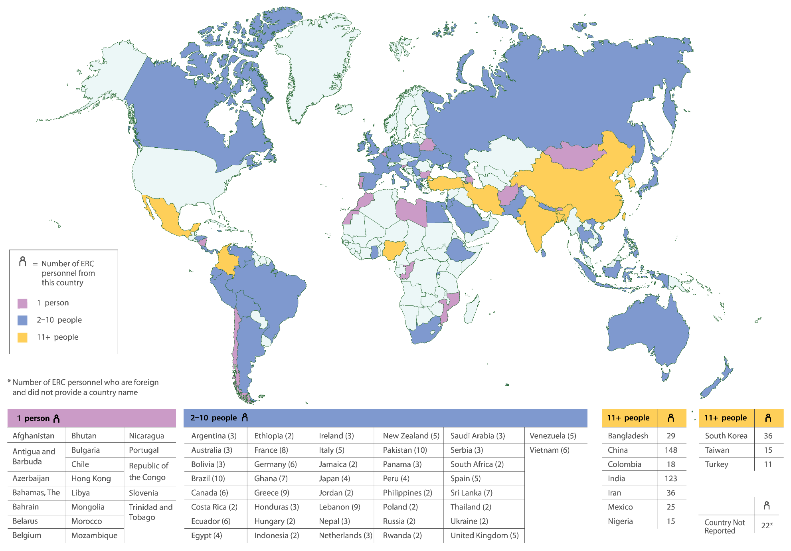
Country of Citizenship of ERC Foreign Personnel, FY 2023

Slide 46
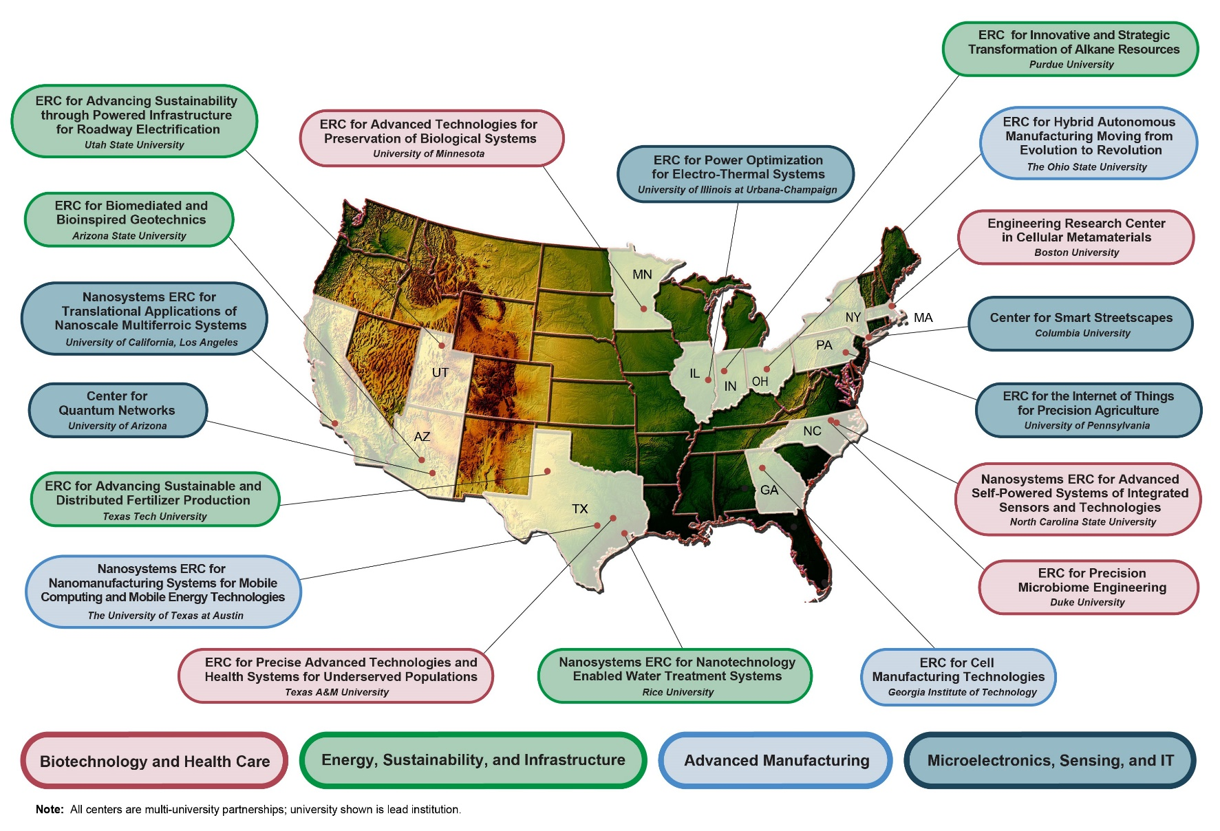
Locations of the Active ERCs, FY 2023

Slide 47
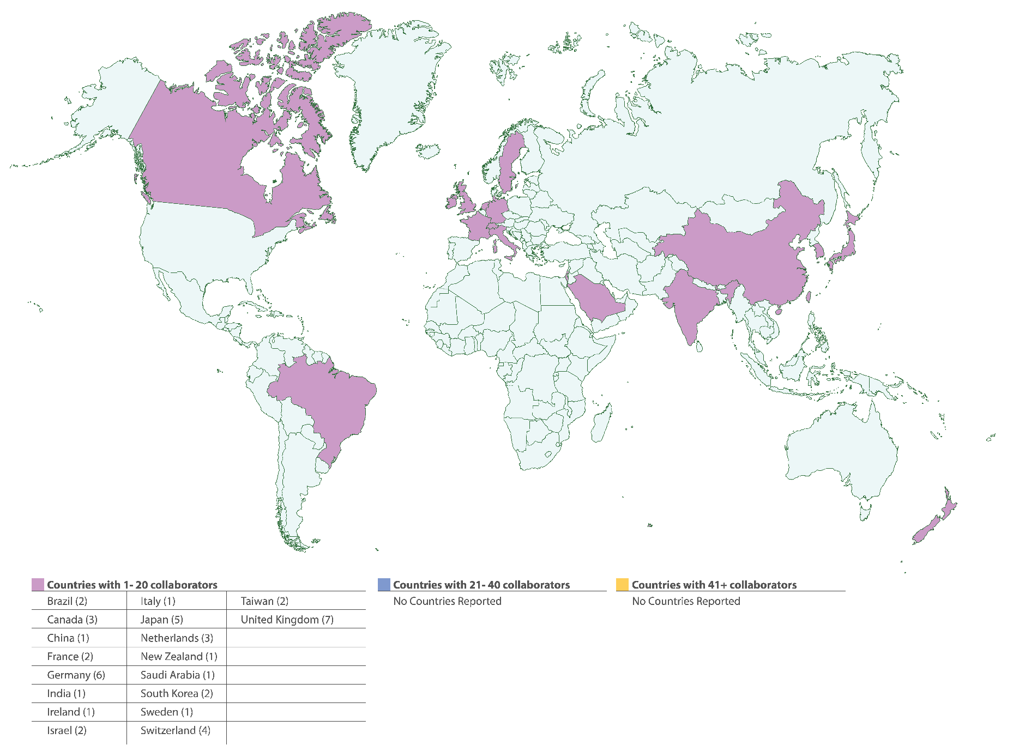
Locations of Foreign Participating Organizations, FY 2023

Slide 48
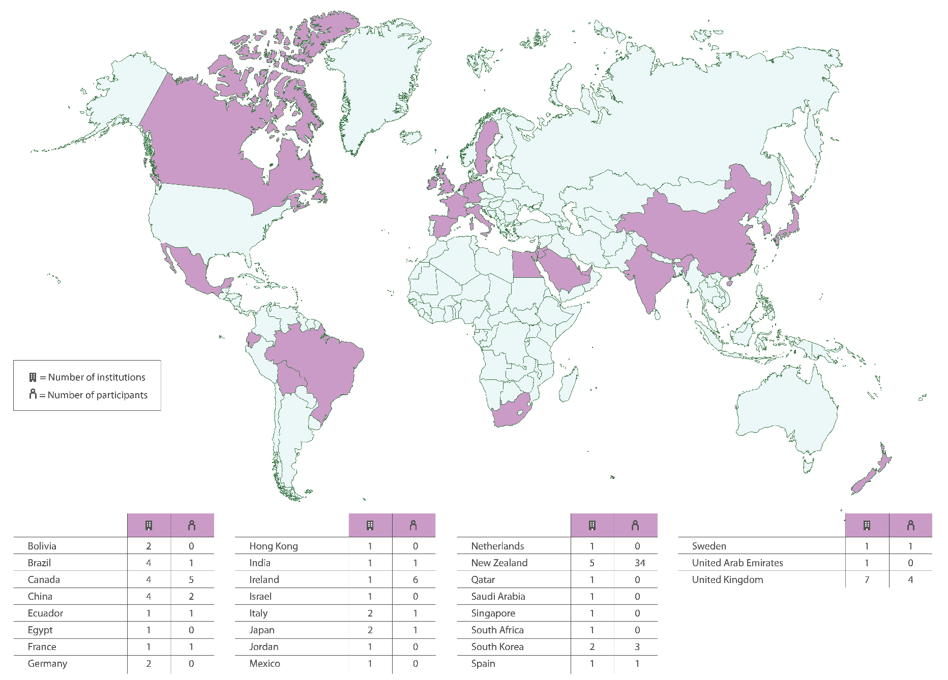
Locations of Foreign Participating Institutions, FY 2023

Slide 49
Number of Institutions and Organizations With Financial Headquarters Abroad Collaborating With ERCs, by Country of Origin, FY 2023*,**
* Displays counts of Industrial/Practitioner members, Funders of Associated Projects, Funders of Sponsored Projects, Contributing Organizations, Collaborating Institutions, Non-ERC Institutions Providing REU Students, and Foreign Partner Institutions
** Community college and Pre-college institutions are excluded
Notes:
Non-ERC Institutions Providing REU Students—Institutions in which the Center’s REU supplement students are enrolled, excluding the Center’s lead and core partners. The sole involvement with the Center is to provide REU students. In many cases, these institutions serve minority populations.

Slide 50
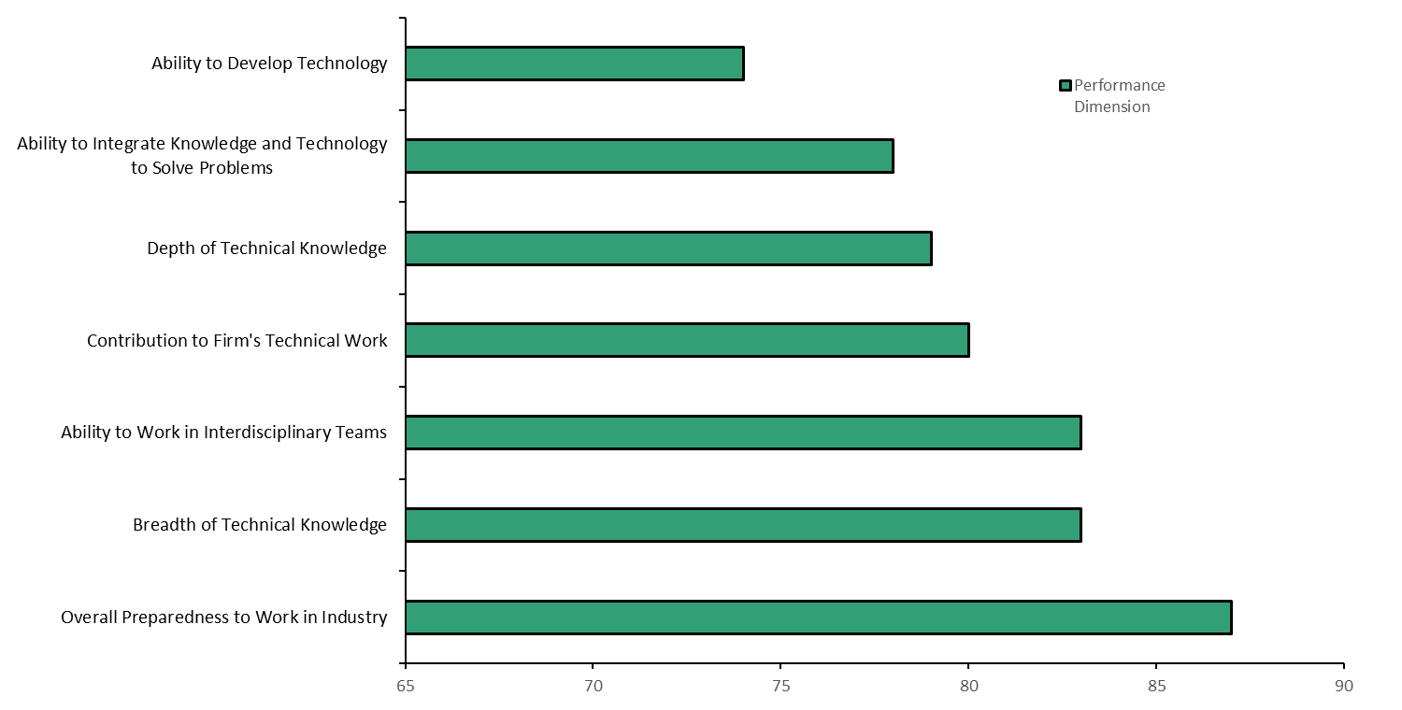
Comparisons by Member Firms of the Performance of ERC Hires vs. Non-ERC Hires*
* Percentage of industrial supervisors rating the former ERC students/graduates hired by their firms as “Better Than” or “Much Better Than” equivalent hires without ERC experience
Notes:
Graduated university participants in Engineering Research Centers are considered to have multidimensional superior capacity in the STEM workforce.
Source data provided by NSF.

