Slide 1

National Science Foundation
Engineering Research Centers (ERC)
Strategic Partner and Innovation (SPI) Director
2021 ILO SUMMIT
September 8, 2021

Slide 2
OUTLINE
How does Gen-4 differ from Gen-3?
What functions are managed in the Innovation Ecosystem?
  Industry Management
  Innovation Management
  Stakeholder Management
How does one know all possible stakeholders have been identified?

Slide 3
OUTLINE
How does Gen-4 differ from Gen-3?
What functions are managed in the Innovation Ecosystem?
  Industry Management
  Innovation Management
  Stakeholder Management
How does one know all possible stakeholders have been identified?

Slide 4
How Does Gen-4 differ from Gen-3?
This ERC solicitation has been informed by a study from the National Academies of Sciences, Engineering, and Medicine (NASEM).
  The program continues to focus on advancing an engineered system through inclusive cross-disciplinary and cross-sector partnerships,
  While placing greater emphasis on research that leads to societal impact through convergent approaches, engaging stakeholder communities, and strengthening team formation.

Slide 5
Changes in ERC Solicitation: Flexibility in Eligibility
Limit on Number of Letters of Intent and Preliminary Proposals:
  Per Institution: None
  Per PI or Co-PI: None
The lead institution must have an Engineering Department/School, offering degrees at the Bachelors, Masters, and PhD level.
A letter of support must be received from the Dean of Engineering at that institution. (Taken care of)
Notes:
PI and Center director can be different, but need to be defined as this stage.

Slide 6
Changes in ERC Solicitation: Flexibility in Personnel
Principal Investigators:
  The Lead PI must be a tenured faculty member at the Lead Institution; cannot change.
  The Lead PI does not have to be from an Engineering Department.
  The Lead PI and the ERC Director are not required to be the same person, but both must be from the Lead Institution.
  Non-Lead PIs are the PIs listed on the Cover Sheet after the Lead PI and may be from institutions other than the lead university.
  Non-Lead PIs do not need to be tenured; may change.
Leadership Roles:
  Opportunity for different models of leadership
  Exception: ERC Administrative Director role is required.

Slide 7
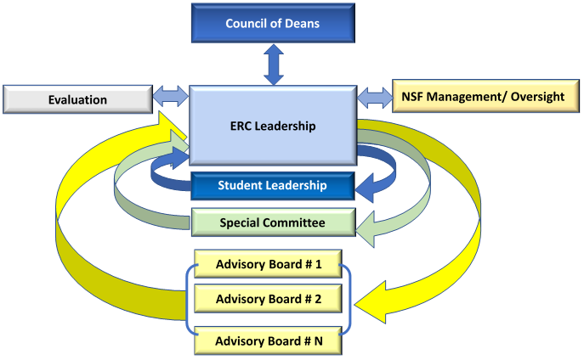
Changes in Solicitation:
Flexibility in Management
Management Structure:
  More freedom and creativity
  Define the roles of various advisory boards/entities
Explain the ERC’s processes for
  Team communication
  Taking in and responding to advisory feedback
Notes:
Before they needed IAB, SAB, now they have more flexibility, but should make sense and align with their goals.

Slide 8
OUTLINE
How does Gen-4 differ from Gen-3?
What functions are managed in the Innovation Ecosystem?
  Industry Management
  Innovation Management
  Stakeholder Management
How does one know all possible stakeholders have been identified?

Slide 9
ERCs are Charged with Nurturing the Innovation Ecosystem
The Gen 4 Innovation Ecosystem is a community of like-minded stakeholders taking advantage of world-class resources proven to deliver results for individuals, teams and organizations, irrespective of geography, industry or company size.
ERC stakeholders are the faculty, students, industry partners, state and local governments, regulatory agencies, anyone impacted by proposed technology, etc.

Slide 10
Strategic Partner and Innovation (SPI) Director
RESPONSIBILITY: Create the strategic plan for nurturing the ERC’s innovation ecosystem. Under that umbrella, the SPI Director defines the organization, reporting structure, and processes needed to complete the following three functions:
  Manage industry partner relations
  Nurture innovation ecosystem
  Engage stakeholders
Generic SPI
Org Chart
Stakeholder
Industry
Stakeholder
Innovation
Notes:
ADD THIS TO THE INNOVATION ECOSYSTEM DECK
We expect these three functions to be managed under one umbrella. The functions could be carried out by a single individual or multiple people. If multiple people, the SPI Director should provide an org chart showing who is responsible for which functions, (a), (b), or (c) and indicate who reports to whom, if a hierarchal reporting structure is used.

Slide 11
Expectations: ERC Innovation Ecosystem
Form strategic partnerships with core industrial/practitioner stakeholders
Speed the translation of research into new processes and products as guided by the logic model
Engage all stakeholders
Follow best practices to optimize utilization of ERC’s knowledge/ technology advances
Foster entrepreneurial culture by engage ERC students in all phases of the innovation process
Notes:
Industry partnership
Governed by a center-wide membership agreement and center-wide IP policy with first option to license ERC-developed IP to members
Provides funding plus guidance on strategic planning, research opportunities, education, the role of innovation in the ERC - SWOT
Translation of research
Sponsored project support by members with special IP
If members do not take IP option, non-member small firms may lead a partnership with the ERC to seek translational research funding
Stakeholders => IAB plus
partnerships with state and local government
university organizations
VCs (“Innovation Partners”) devoted to accelerating innovation & entrepreneurship
User and beneficiary communities
Students → innovation exposure
including experience in translating discoveries into innovations
Key role of the university in the innovation ecosystem to speed the formation of new ventures by:
Sustaining cultures of innovation by integrating research, commercialization, and life-long skill development
Building bridges from discovery to technology innovation and commercial reality, i.e., TRL 1-9
Transforming engineering workforce through imparting innovation and entrepreneurship skills
Producing diverse engineering graduates who can compete in a globally competitive world where design and production efforts cross national borders

Slide 12
ERC Partnerships with Stakeholders
Foundation of Innovation Ecosystem
Partnership goals: information exchange, technology transfer, and student impact
Establish Industry Advisory Board governed by a center-wide Membership Agreement and IP Policy—establishes policies, membership fees and benefits, etc.
Notes:
Other opportunities for collaboration opportunities:
1. Joint projects between ERC and industrial researchers - Sponsored projects
2. Industrial mentors for students, industrial residency at ERC
3. Student internships in industry
4. Project/Technology Champions

Slide 13
Expectations of SPI Director
SPI Director is on the ERC Leadership team;
Define for each functional group
  How often they group meets
  Do they provide SWOT analysis
Provide input to strategic planning and project selection/evaluation
Generic SPI
Org Chart
Stakeholder
Industry
Stakeholder
Innovation

Slide 14
Roles and Responsibility for Industry Management Function
Set vision and strategic plan for industry
Market ERC to industry across the IAB value chain
Develops and finalizes cross-university membership agreement and IP policy
Finalizes Industry partner membership agreement and seals the deal to collect fees
See Chapter 5 of ERC Best practices Manual
https://erc-assoc.org/best_practices/best-practices-manual

Slide 15

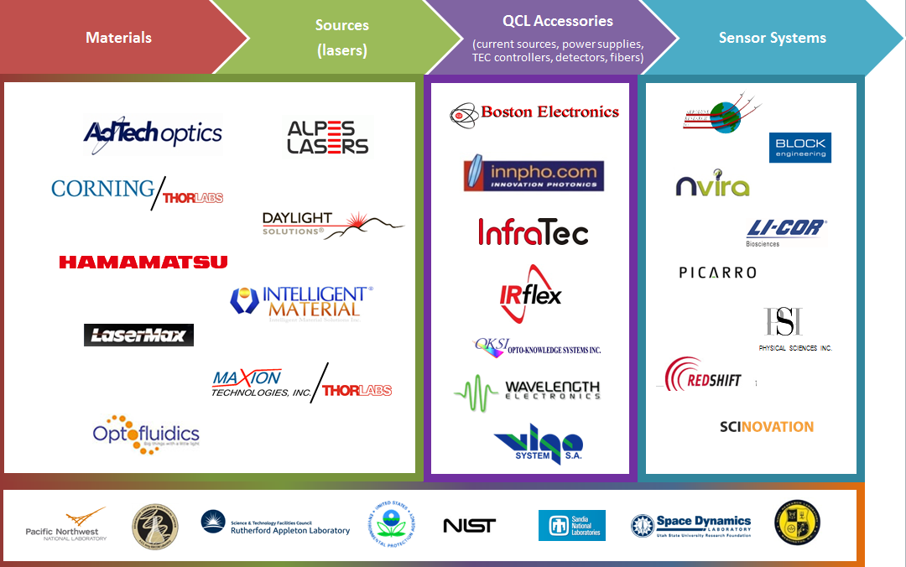
Members in MIRTHE’s Industry Value Chain
Small/large
Companies (R&Ds)
National Laboratories – early adopters
Credit: MIRTHE ERC
Notes:
15
This center has a fairly balanced value chain, including national laboratories and early adopters.

Slide 16
Roles and Responsibility for Innovation Function
Manages the translational research process
Develops partnerships to accelerate innovation with state and local government agencies and VCs
Integrates innovation ecosystem program with ERC’s education program and strategic vision for diversity and a culture of inclusion
See Chapter 5 of ERC Best practices Manual
https://erc-assoc.org/best_practices/best-practices-manual

Slide 17
Roles and Responsibility for Stakeholder Function
Stakeholder engagement can take many forms;
  Engaging advocacy groups;
  Forming innovation partnerships
  Seeking membership partners who facilitate tech diffusion
  Bringing on individual consultants
  Creating associate membership category
Formalization mechanisms
  How often do they interact with the ERC Team?
  What is the nature of the interaction?
  Do/should they generate a SWOT?
  Do/should they generate a report?
This function is new to the Gen 4 ERC.

Slide 18
Gen-4 ERC Stakeholder Definition (pick one)
All entities impacting or being impacted by the ERC’s Engineered System?
Any entity that has an opinion about how the engineered system should be developed and/or rolled out.

Slide 19
OUTLINE
How does Gen-4 differ from Gen-3?
What functions are managed in the Innovation Ecosystem?
  Industry Management
  Innovation Management
  Stakeholder Management
How does one know all possible stakeholders have been identified?

Slide 20
Suggested Process for Identifying Relevant Entities
What entities impact available funding?
  Commercial funding
  Government funding
  NGOs and charities
What entities or groups comprise the end-user community ?
What entities or groups are impacted by the technology?
  Is it a net positive impact
  Is it a net negative impact
What entities provide the governing frameworks that define the interactions among A, B, and C above?
  Policy
  Regulatory agencies
  Laws reflecting social desires
  Tax incentives
  Established customs
  Etc.

Slide 21
Site Visit Risk Management Process

Slide 22

National Science Foundation
Engineering Research Centers (ERC)
NSF UPDATES

Slide 23
NSF UPDATES
New Consulting Contract with Elysium Holdings
  Erik Sander
  Scott Ransom
NSF’s new TIP Directorate
Innovation Ecosystem Funding Options
  SBIR/STTR
  GOALI
  SECO
  INTERN
New I/UCRC Option

Slide 24
Biden Budget: New NSF Directorate
$10.2 billion for NSF in 2022 (20% increase)
New TIP research directorate aims to “move research more quickly to marketplace”
  TIP →Technology, Innovation, and Partnerships
  Initial budget $865 Million
https://www.science.org/news/2021/05/biden-backs-new-nsf-tech-directorate-senate-balks

Slide 25
I/UCRC & INTERN Options
NSF IIP Program Directors
Prakash Balan – pbalan@nsf.gov
Crystal Leach – crleach@nsf.gov

Slide 26
Innovation Ecosystem Funding Sources
SBIR/STTR https://seedfund.nsf.gov/
GOALI https://www.nsf.gov/eng/iip/goali.jsp
SECO https://www.nsf.gov/pubs/2015/nsf15043/nsf15043.jsp
INTERN https://www.nsf.gov/publications/pub_summ.jsp?ods_key=nsf21013

